Slide 1
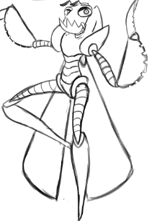
Unity Game Design Specifications
Team members: Anthony Jamora, Thomas Burke, Jonathan Nabors

Slide 2
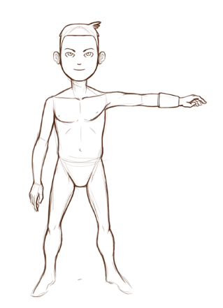
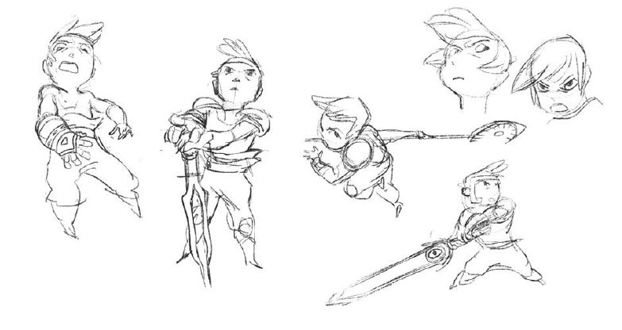
Game Description
Interactive, Immersive, Entertaining
Imaginative, original environments
Target audience is expecting:
Freedom to explore
Strong Storyline

Slide 3
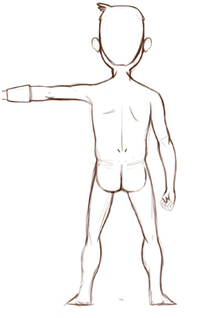
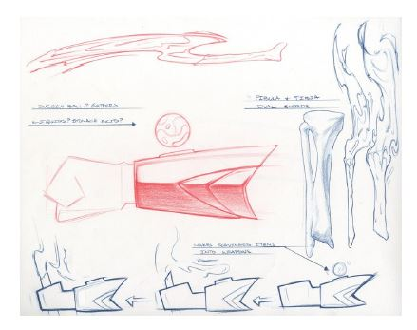
Functional Specifications
Rewards curious and adventurous players
Victory conditions
Winning
Losing
Game Elements
Health/Stamina
Obstacles
Items

Slide 4
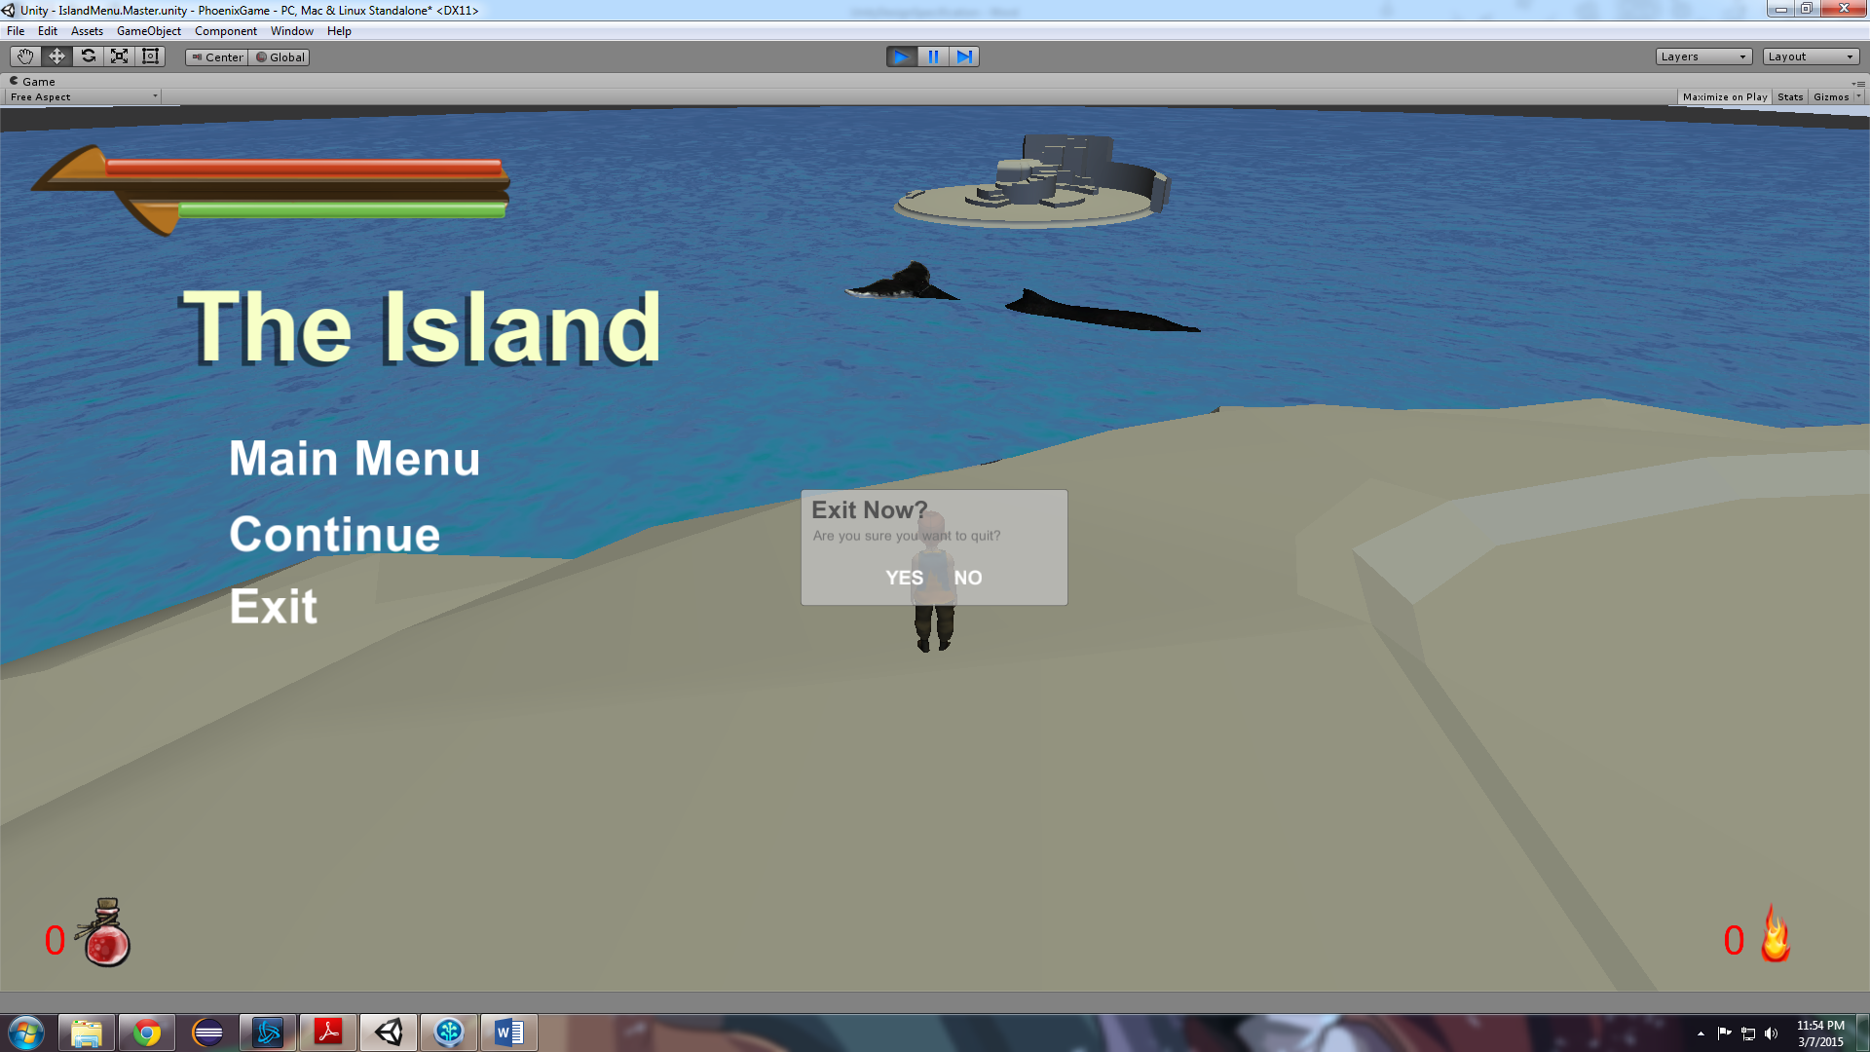
User Interface and Menus
Splash Screen
Menus
HUD
Brightness
70% - 130%
Resolution
16:9 Support
Graphics
Low-High

Slide 5
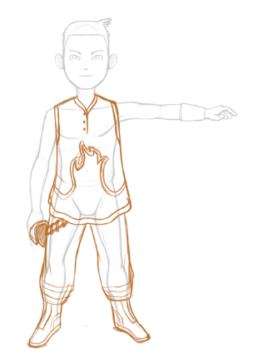
Main Menu Flow Diagram
Represent Wayne State
Simple
Intuitive Navigation

Slide 6
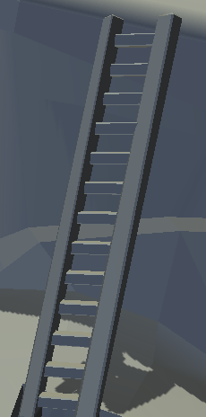
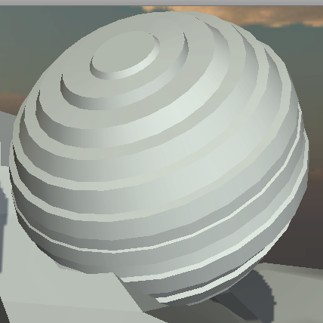

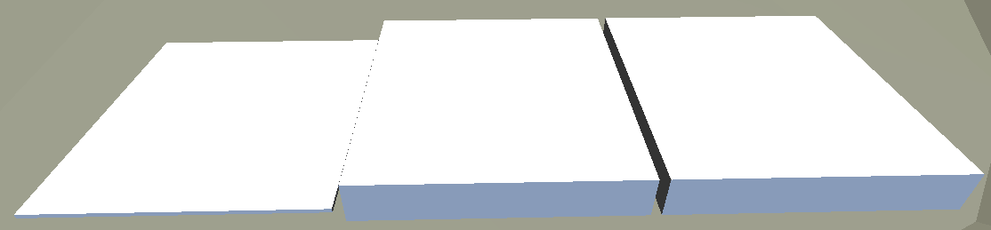
Art & Video
Obstacles
Terrain
Game Play Elements
Special Effects
Marketing and Packaging Art
Puzzles

Slide 7
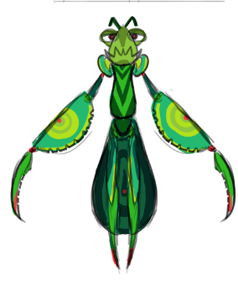
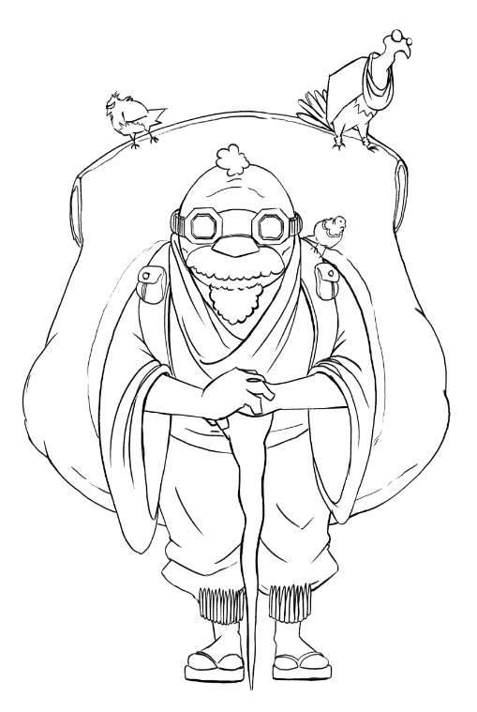
Sound and Music
Music
Ambiance
Combat
Menu
Sounds with animations
Sounds with particles
Grunts

Slide 8
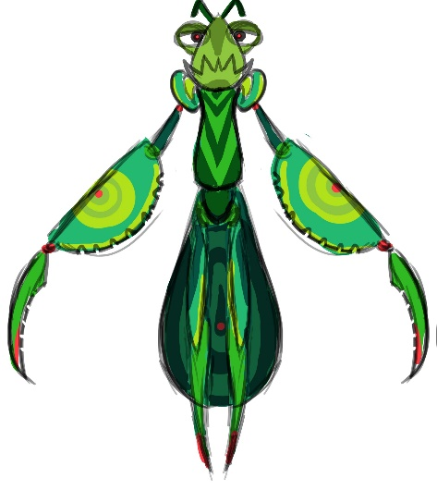
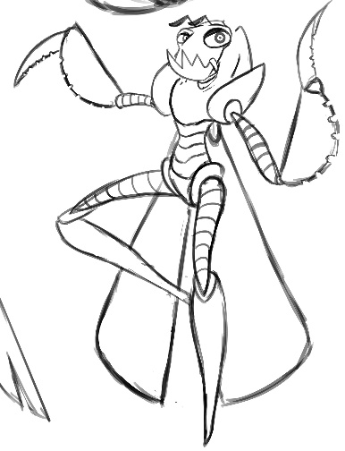

Characters
Player
Health/Stamina
Animations
Friendly
Chat Bubble
Enemies
Vision Range

Slide 9
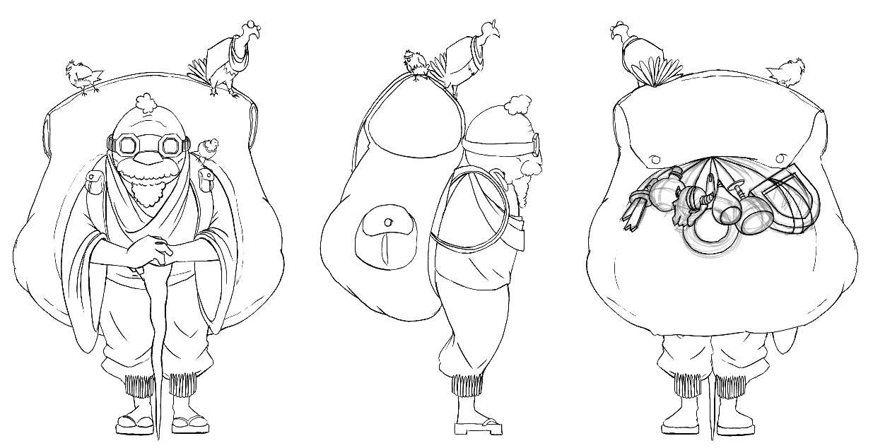
Technical Specifications
Naming Conventions
Scripts
For each Interaction
Structure
Game Objects Architecture
Transform
Rigidbody
Colllider
Script

Slide 10
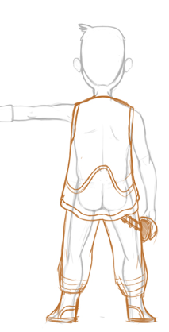
Technical Specifications continued
Artificial Intelligence
Vision Range
Return Range
Waypoints
Hardware Architecture
I/O devices
PC

Slide 11
Use Cases
Actors
Menu Use Cases
Begin new game
Options
Credits
Exit Game
10 Total
Character Use Cases
Move
Attack
Use Item
Interact
12 Total

